Slide 1
Successive Convexification for the Powered Descent Guidance Problem
Pádraig Lysandrou

Slide 2
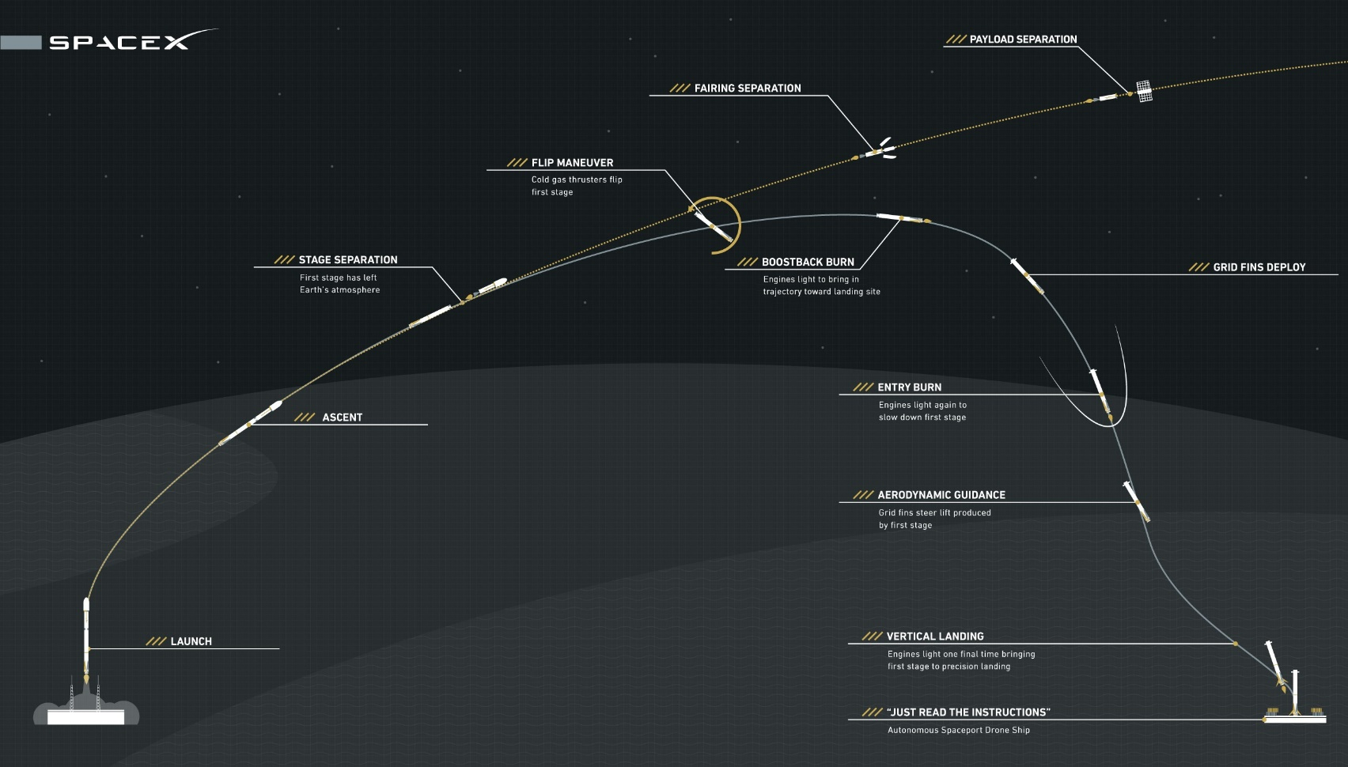
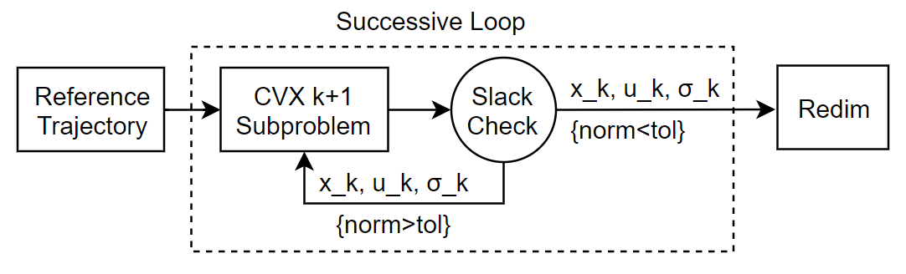
A 6DoF Powered Descent Guidance Approach
Modified implementation of Szmuk/Acikmese 2018 in CVXpy – ECOS solver
Sequential algorithm, factoring full nonlinear dynamics, full-state reference trajectories
Applied to pin-point landing for VTVL’s with throttleable engine, TWRs > 1
Amenable to online implementation and a powerful offline tool
Research question: how to form a sequential optimal guidance algorithm, informed by NL dynamics and actuator constraints?

Slide 3
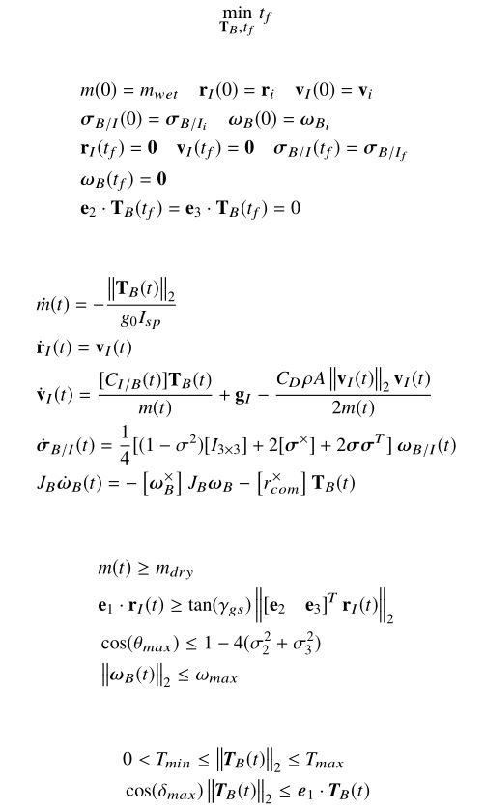
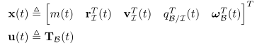
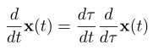
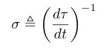
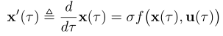
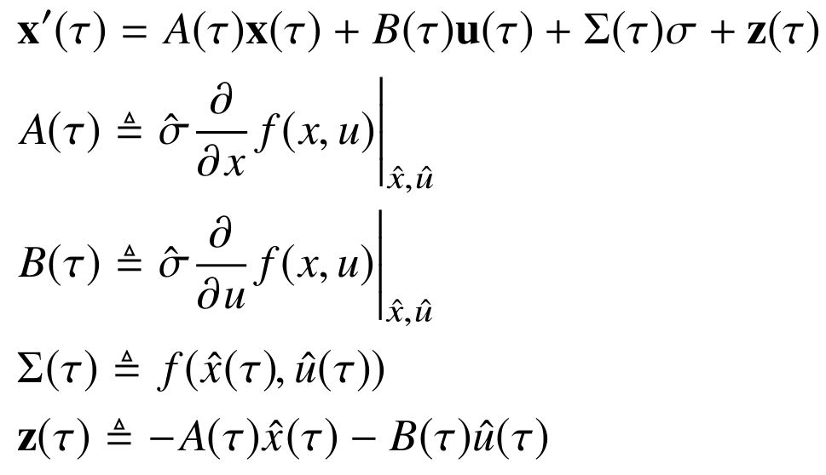
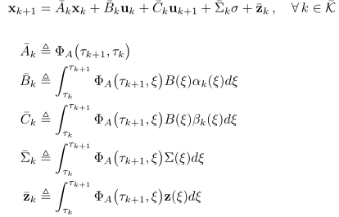
Overview: Continuous to Discrete SOCP Subproblem
Use of nondimensional time dilation coefficient
Discretization of LTV System
Non-convex lower bound

Slide 4
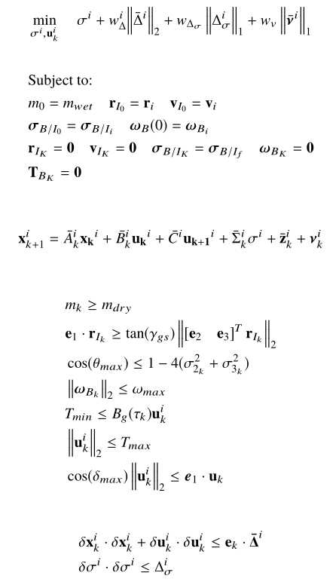
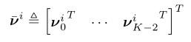
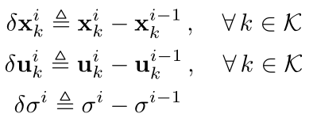
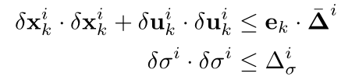
Convex Subproblem and Successive Routine
Dynamic Relaxation added to counter “Artificial Infeasibility”
Trust Regions to ensure boundedness and dynamic feasibility throughout
convergence
Github Repo here
Notes:
Infeasibility and trust regions have high penalization!

Slide 5
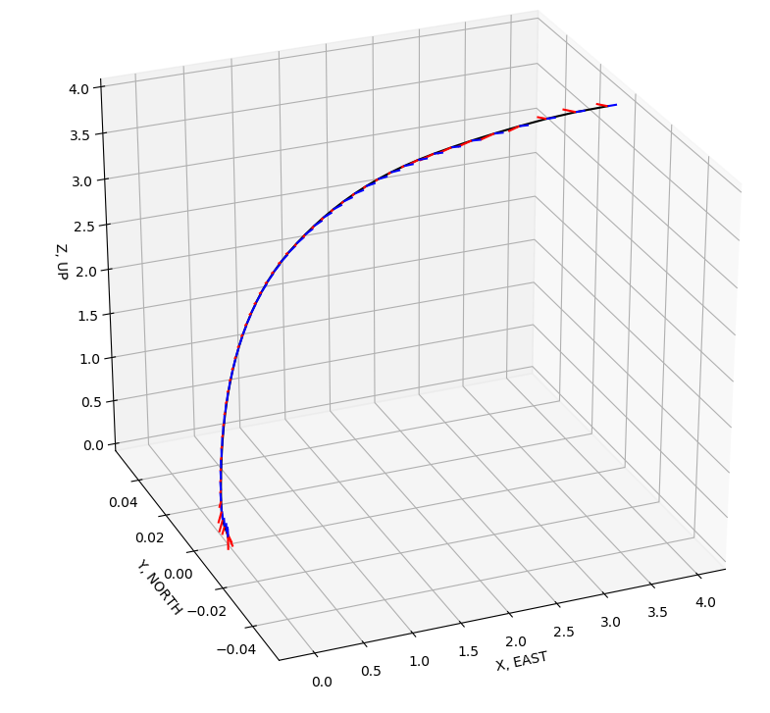
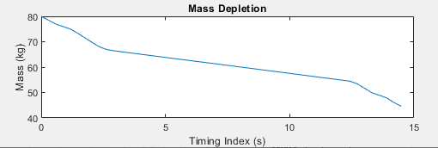
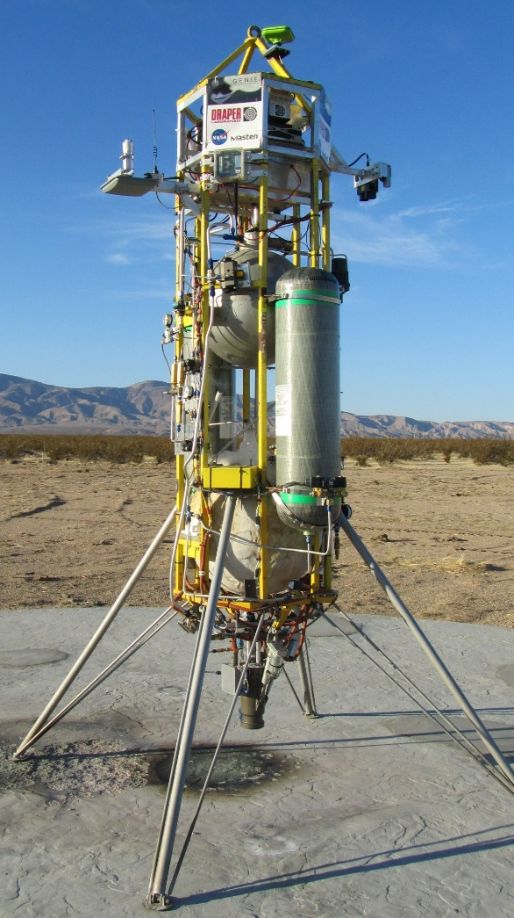
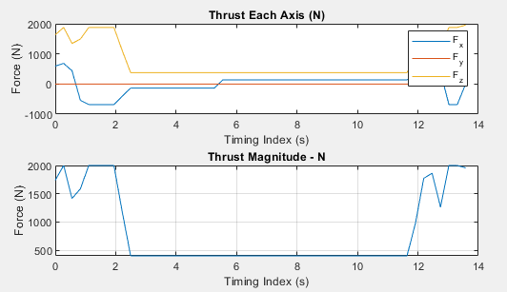
Python Implementation – Planar Divert
Dimensionalized properties for small lander like the Masten Space Xombie Vehicle.
For K=10, compute time 4.6 seconds on unoptimized platform, 6 iterations, (Image is K=50)
Notes:
Just make sure your constraints have the right actuator values

Slide 6
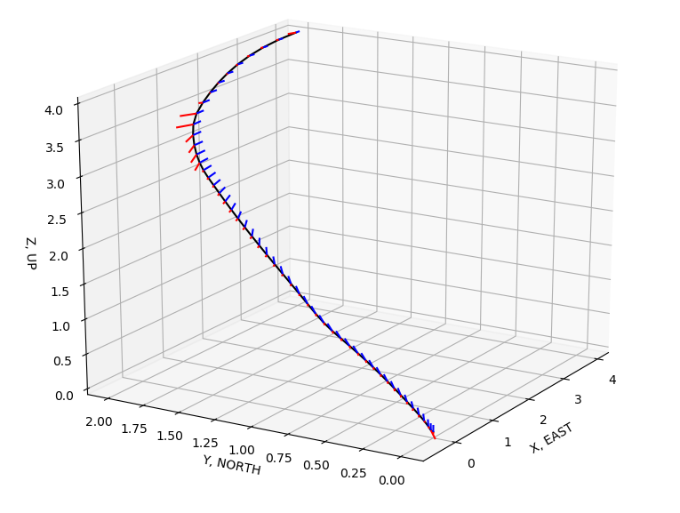
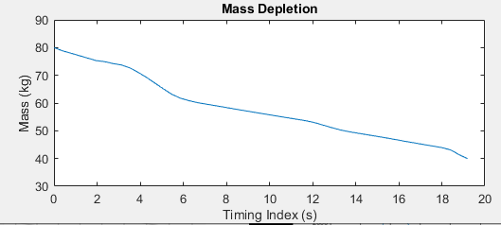
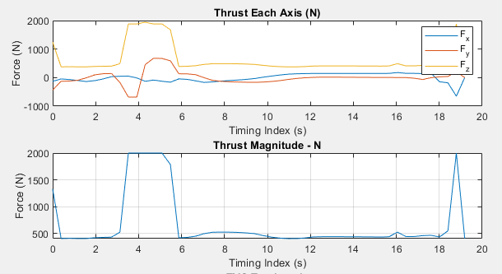
Large Non-Planar Diverts
Remains dynamically feasible – similar computation speeds
All dynamic constraints are met

Slide 7
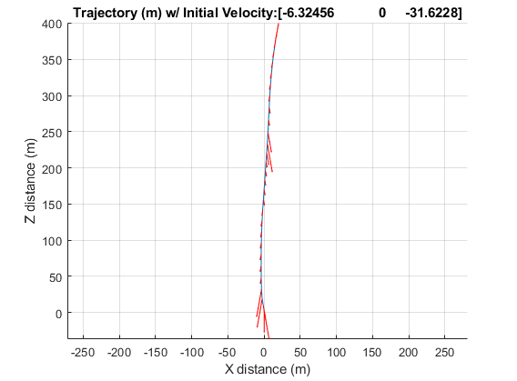
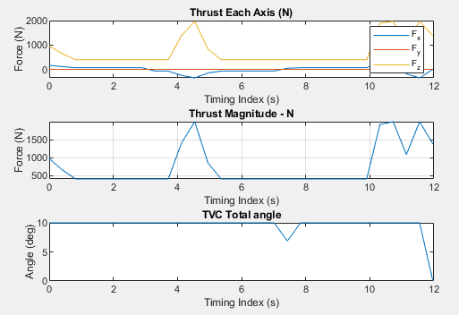
Terminal Descent: Falcon-esque Dogleg Maneuver
Satisfies dynamics, and becomes a simplified planar problem.
Extra state constraints can be added to make sure landing is ‘from above’

Slide 8
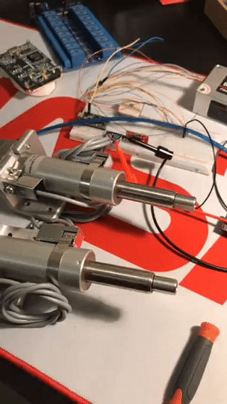
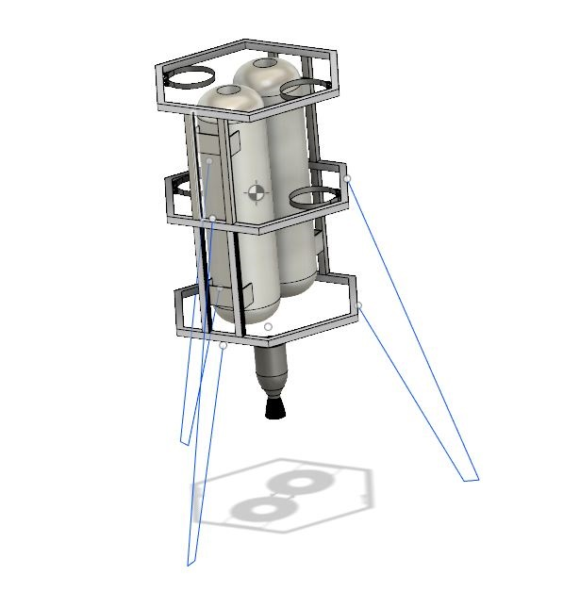
Okay fine, but can you implement this?
Goal: build a 60 second flight-time-capable landing testbed for GNC algorithm development
Keep it scrappy, but safe, budget <$12k
Doable by refurbishing repaired equipment, various internet sources
Flight representative dynamics, sensors, avionics, and actuators
Make the vehicle its own test-stand
Abstract guidance routines to 1GHz computer, with Nav and Control tasks performer quasi-real-time on 600MHz MCU
Active Budgets:
Monetary, propulsion and feed, power, and communications

Slide 9
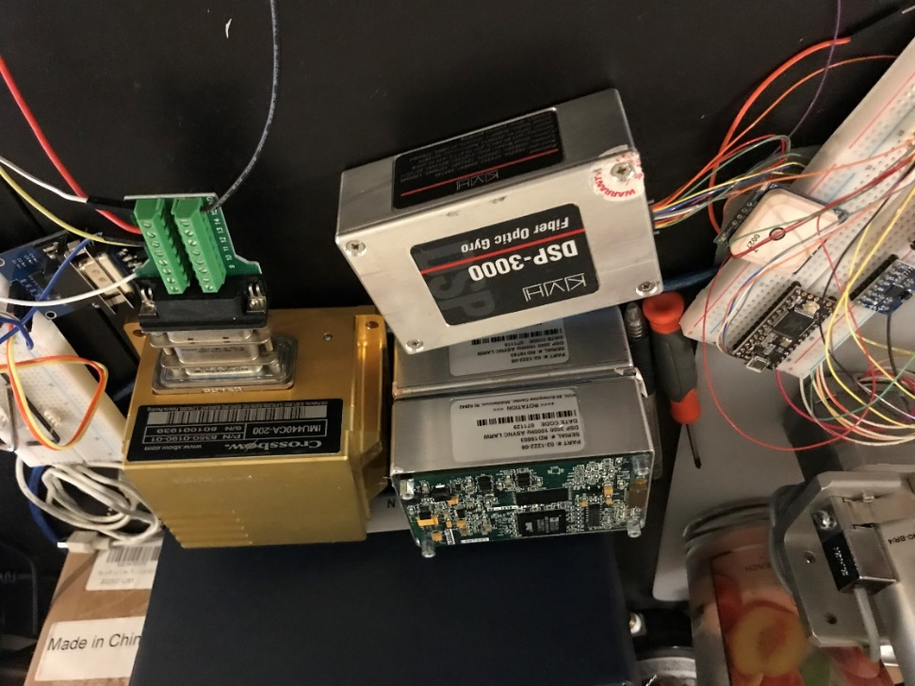
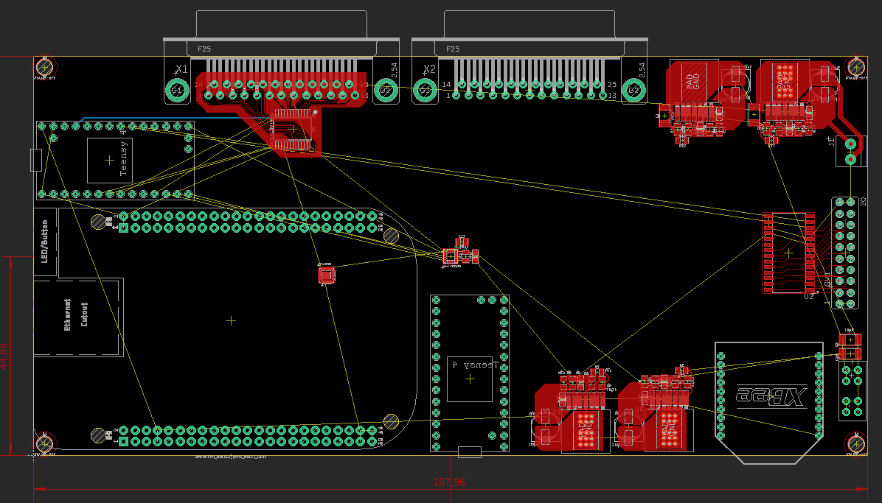
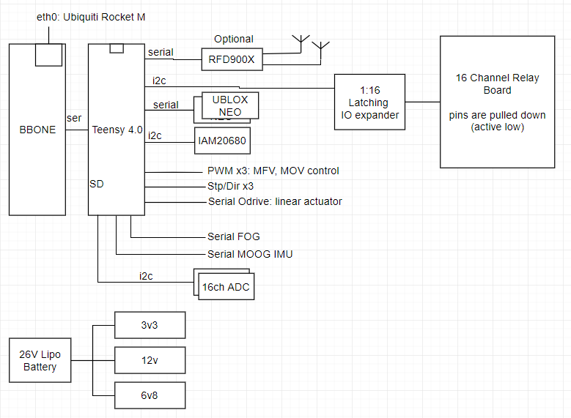
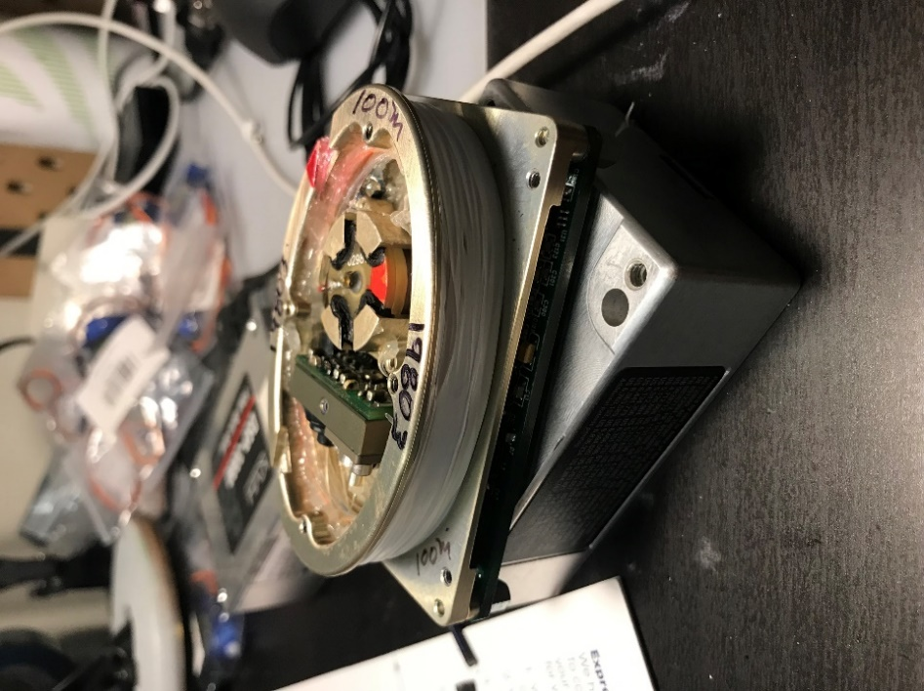
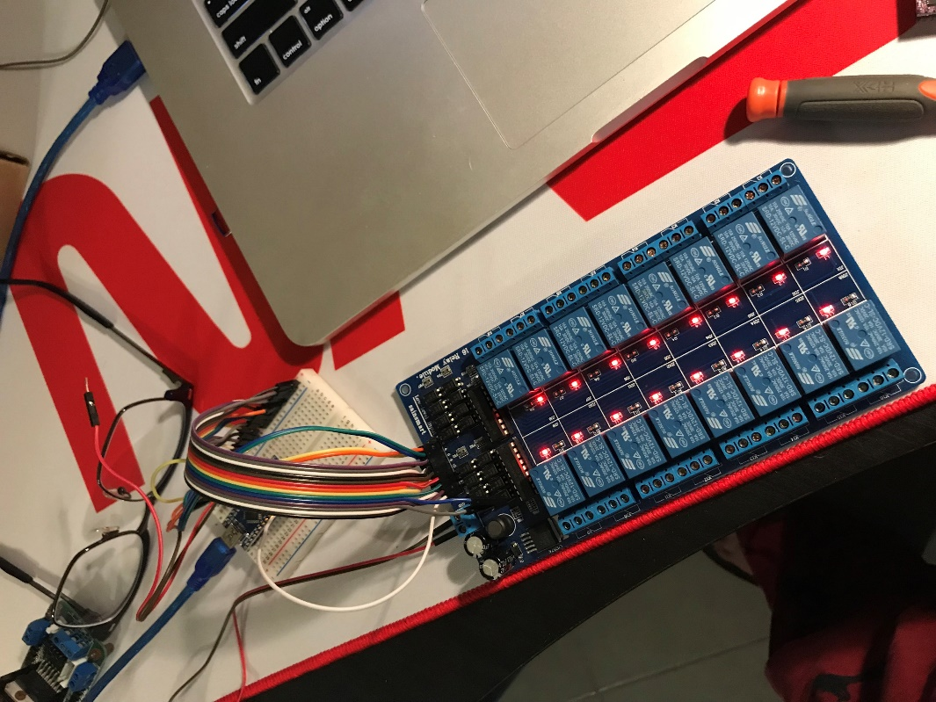
Avionics – Flight Computer and Sensors
Flight computer 1GHz BeagleBone with 600MHz Teensy MCU, this mates with 16Ch relay board
FC connected over ethernet to modem, able to SSH directly in for high bandwidth telemetry during testing
Latching IO expanders for relays and external ADCs
Used Moog XBow IMU has been tested
Playing around with ‘broken’ KVH DSP3000 single axis fiber optic gyroscopes
Likely won’t end up using these
Repaired power rails

Slide 10
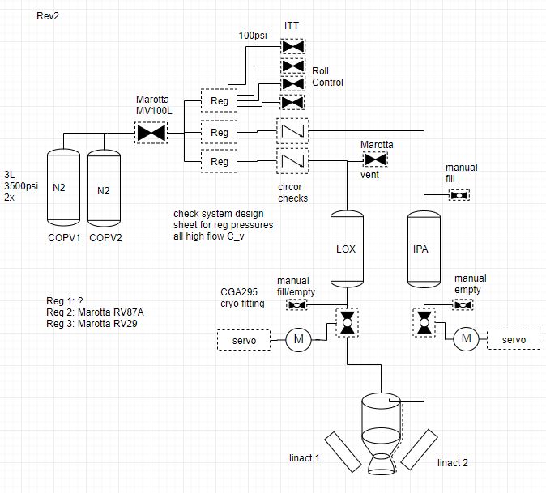
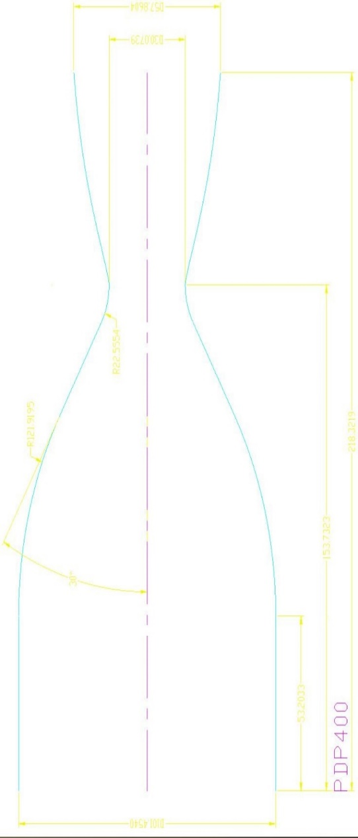
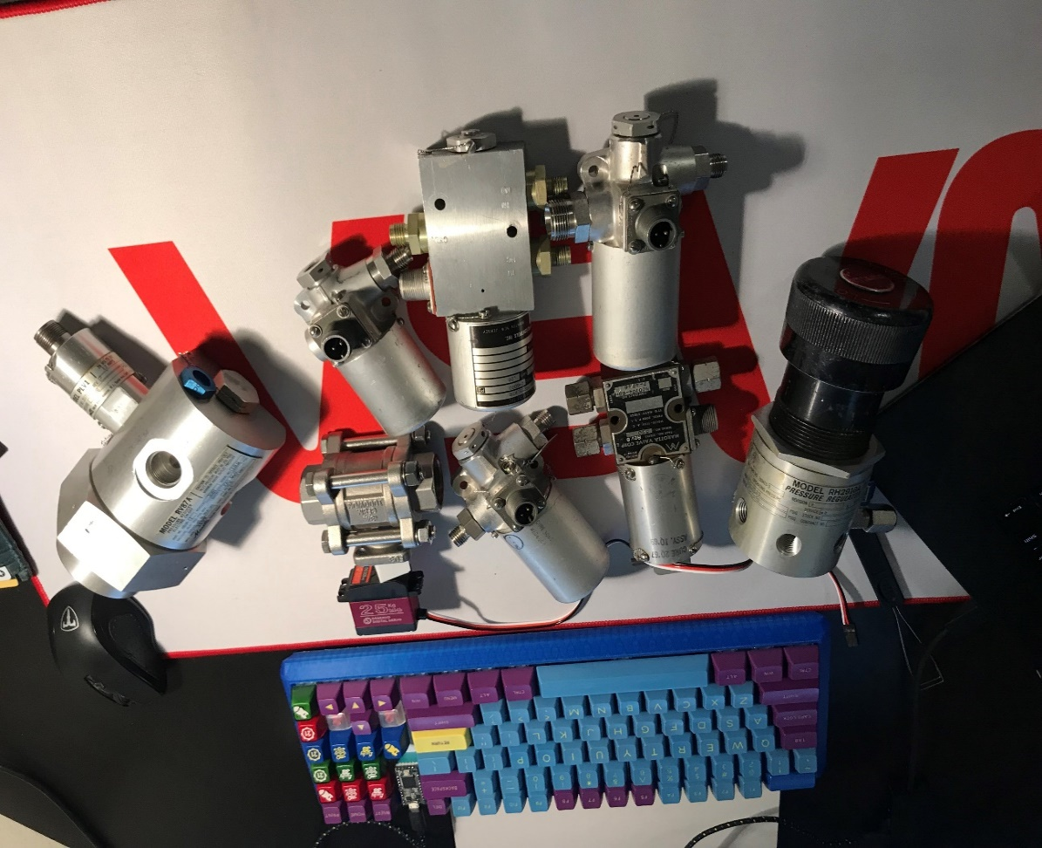
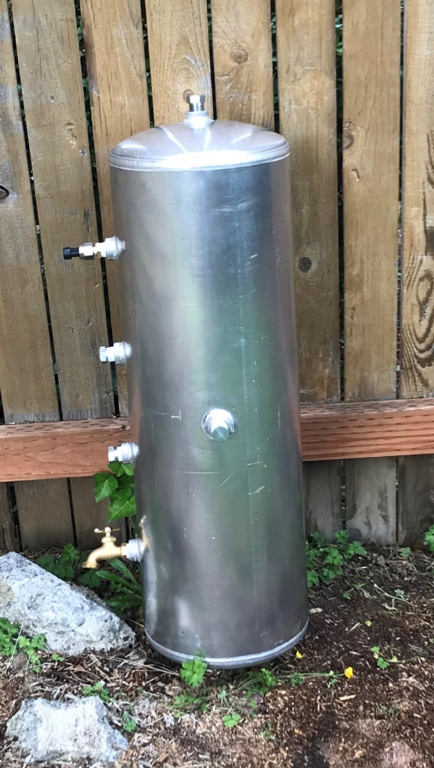
Propulsion System
Pressure-fed 450lbf LOX/IPA film cooled system
Motorized ball valves for flow control
Significant help from propulsion friends
Most valves, regulators already purchased and tested: 60’s/70’s NASA Marotta old stock
Abstracting the cryo side for now: this will take more thought and time
Tank hydro-static testing ongoing
Film-cooling with allow either cast or 3D printed Inconel solution for chamber

Slide 11
Conclusion
Next steps:
Finish full simulation framework with actuator dynamics and test multiple control architectures
Validate same C-Ecos guidance, and C control code on BeagleBone board
Finish flight computer layout and get fabricated
Get Airframe segments welded
Finish propulsion design, film cooling and injector orifice design
Finish linear actuator development (higher bandwidth choices)
Write drivers for IMU440 and DSP3000 -> write UKF in embedded C
Much more…
Thanks!
Questions?

Slide 12
Backup
Other projects documented here: www.Lysandrou.com
Including drone LQG, mode switching attitude control, RWA and CMG GNC framework, randomized algorithms, other fun hardware

Slide 13
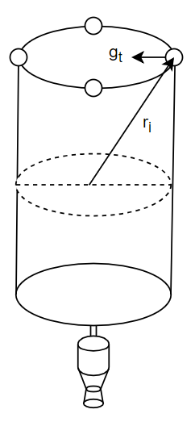
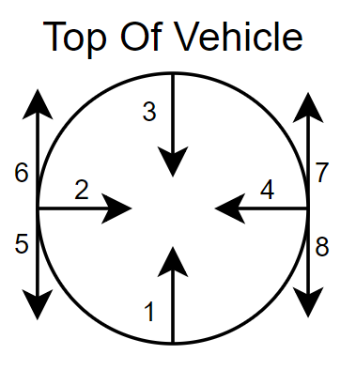
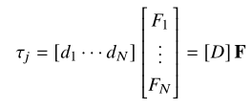
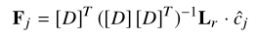
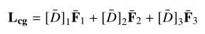
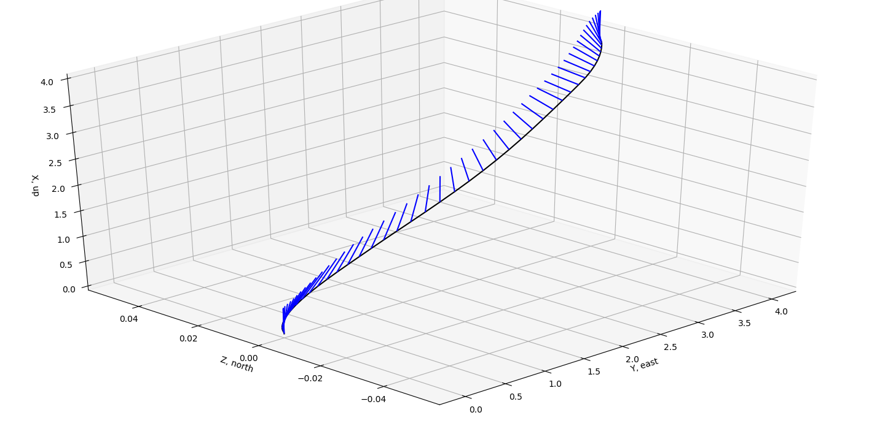
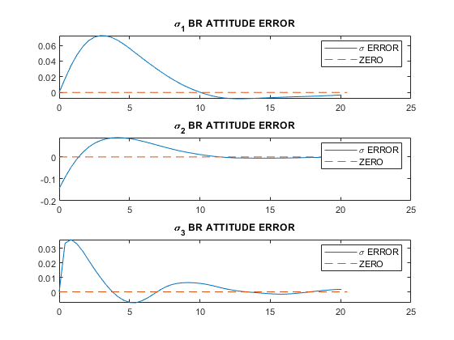
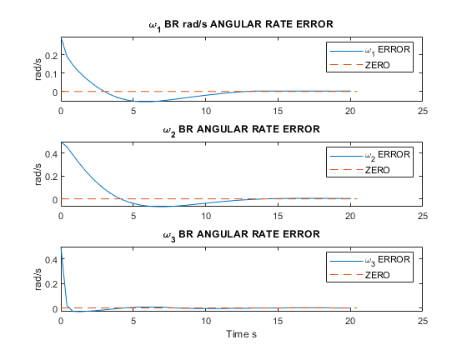
Modular ACS Thruster Framework
Lyapunov-derived attitude control law
Can write distribution as such
Minimum norm inverse to produce
Desired force
Search F_j for positive components,
Find reduced set of directions and forces

